Slide 1


Sprinboard Data Science Capstone Project 1
Rental Bike Count Prediction in Seoul, Korea
Tzu-Ying Chen

Slide 2
Problem and Data Source
Seoul, South Korea is one of the world largest metropolitan area, with around 24 million people living in the city. The transportation within the city has become a public issue to be solved. Rental bikes are then introduced to Seoul for the eco-friendly solution for the commuters and the enhancement of mobility comfort. In order to gain revenue and achieve promised service level, the bike rental companies need to ensure the rental bikes are available and accessible while maximizing the usage and minimizing the idle time.
The data set for this project contains 8,760 observations including weather information, such as temperature, humidity, and windspeed, the number of bikes rented per hour, datetime information, such as holidays and date.
The data set is available on UCI Machine Learning Repository. The page contains information about the data set and its source and relevant scientific publications:
https://archive.ics.uci.edu/ml/datasets/Seoul+Bike+Sharing+Demand#

Slide 3
Data Story
Type of variable
Predictor Variable
Target Variable
Data Type
String
Integer
Variable Category
Categorical
Continuous
temperature
rented_bike_count
humidity
wind_speed
visibility
dew_point_temperature
solar_radiation
rainfall
snowfall
holiday
functioning day
seasons
date
Float
Datetime
date
temperature
wind speed
dew point
solar radiation
rainfall
snowball
visibility
humidity
hour
rented bike count
Seasons
Holiday
Functioning Day
Seasons
Holiday
Functioning day
hour (?)
temperature
humidity
wind speed
visibility
dew point
solar radiation
rainfall
snowfall
hour

Slide 4
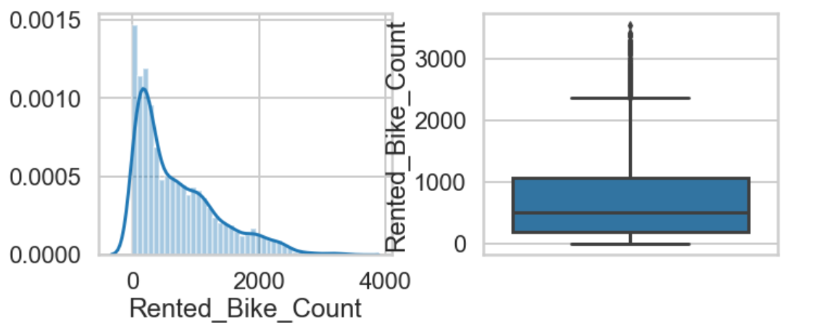
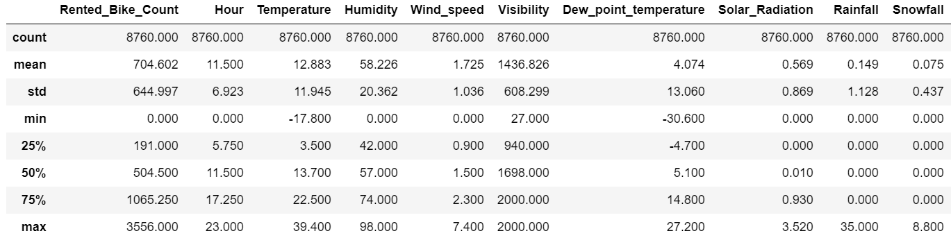
Exploratory Data Analysis – Univariate analysis

Slide 5
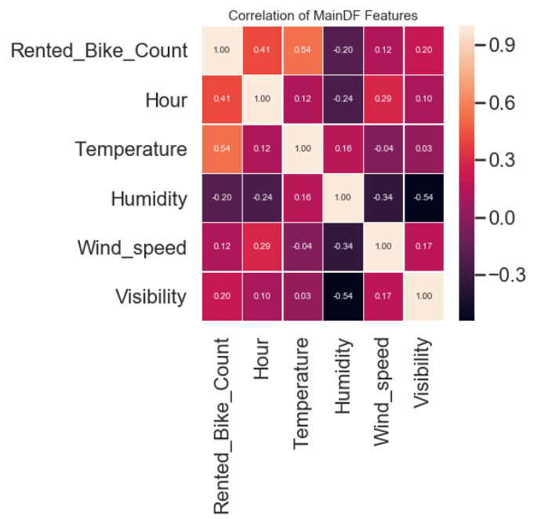
Bivariate Analysis
The relationship of two variables
There is no strong relationship between any of the two.

Slide 6
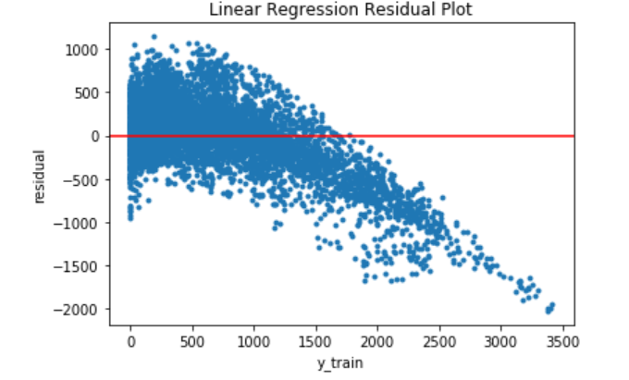
Model – Linear Regression
The training result for linear regression is not that optimal
The r-squared is showing 0.549
The mean absolute error is 321.93

Slide 7
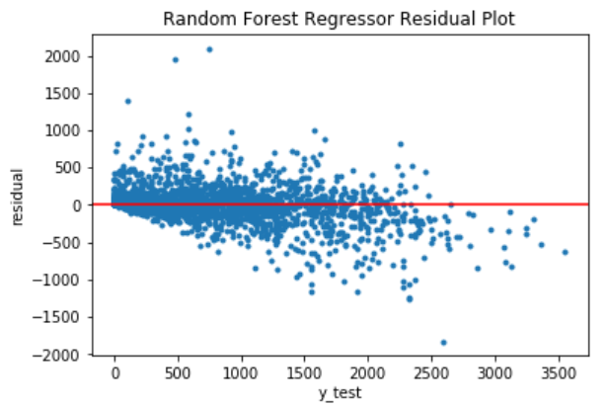
Model – Random Forest Regressor
Model is fitting well
R-squared showing 0.97
Mean absolute error 139
After tuning: 134

Slide 8
Summary and Next Step
Random forest regressor model is a good option for the bike rental prediction problem. The model can better help the rental bike company manage their rental bike supply and demand and achieve greater profits. The company can also work on maintenance of the bike by avoiding high demand hours.
In addition, there are some future improvements that can be done in the project, such as better hyperparameters tuning to get better prediction result, trying different machine learning model, such as SVM and gradient boost model.

